Slide 1
NFTeapot Clone Merchant Experience
https://apps.shopify.com/nfteapot

Slide 2
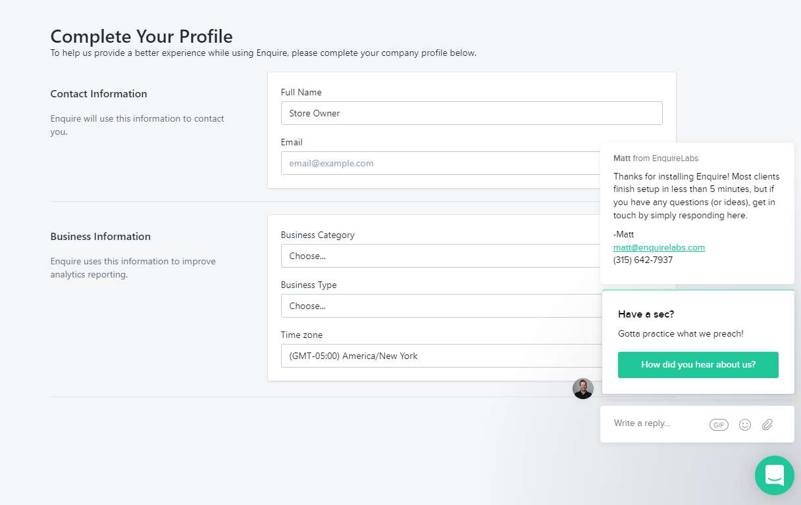

Slide 3
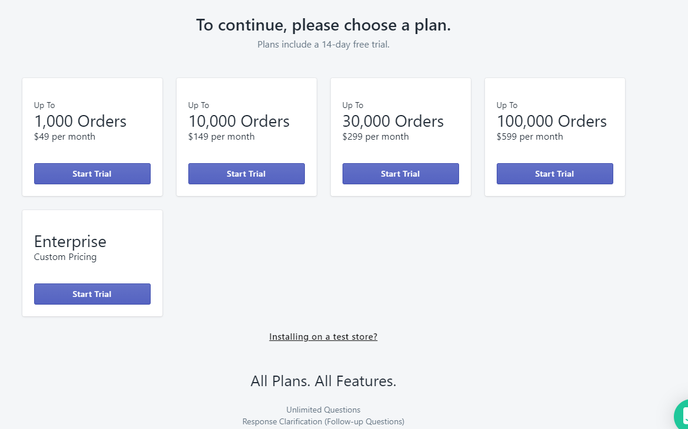

Slide 4
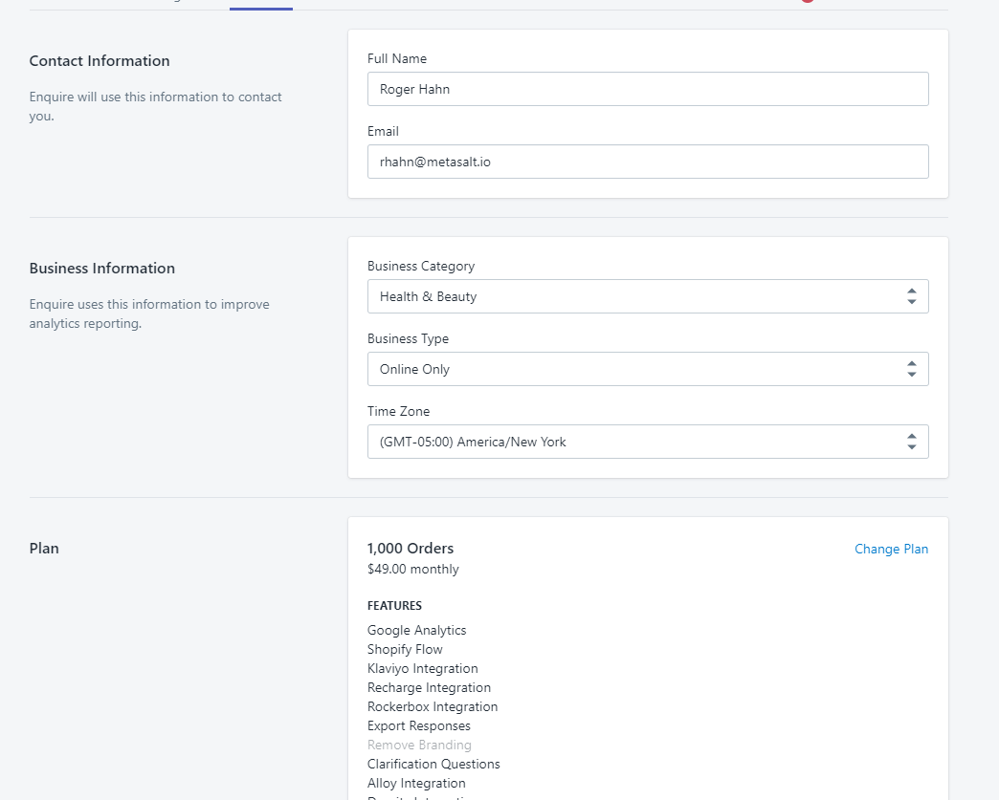

Slide 5
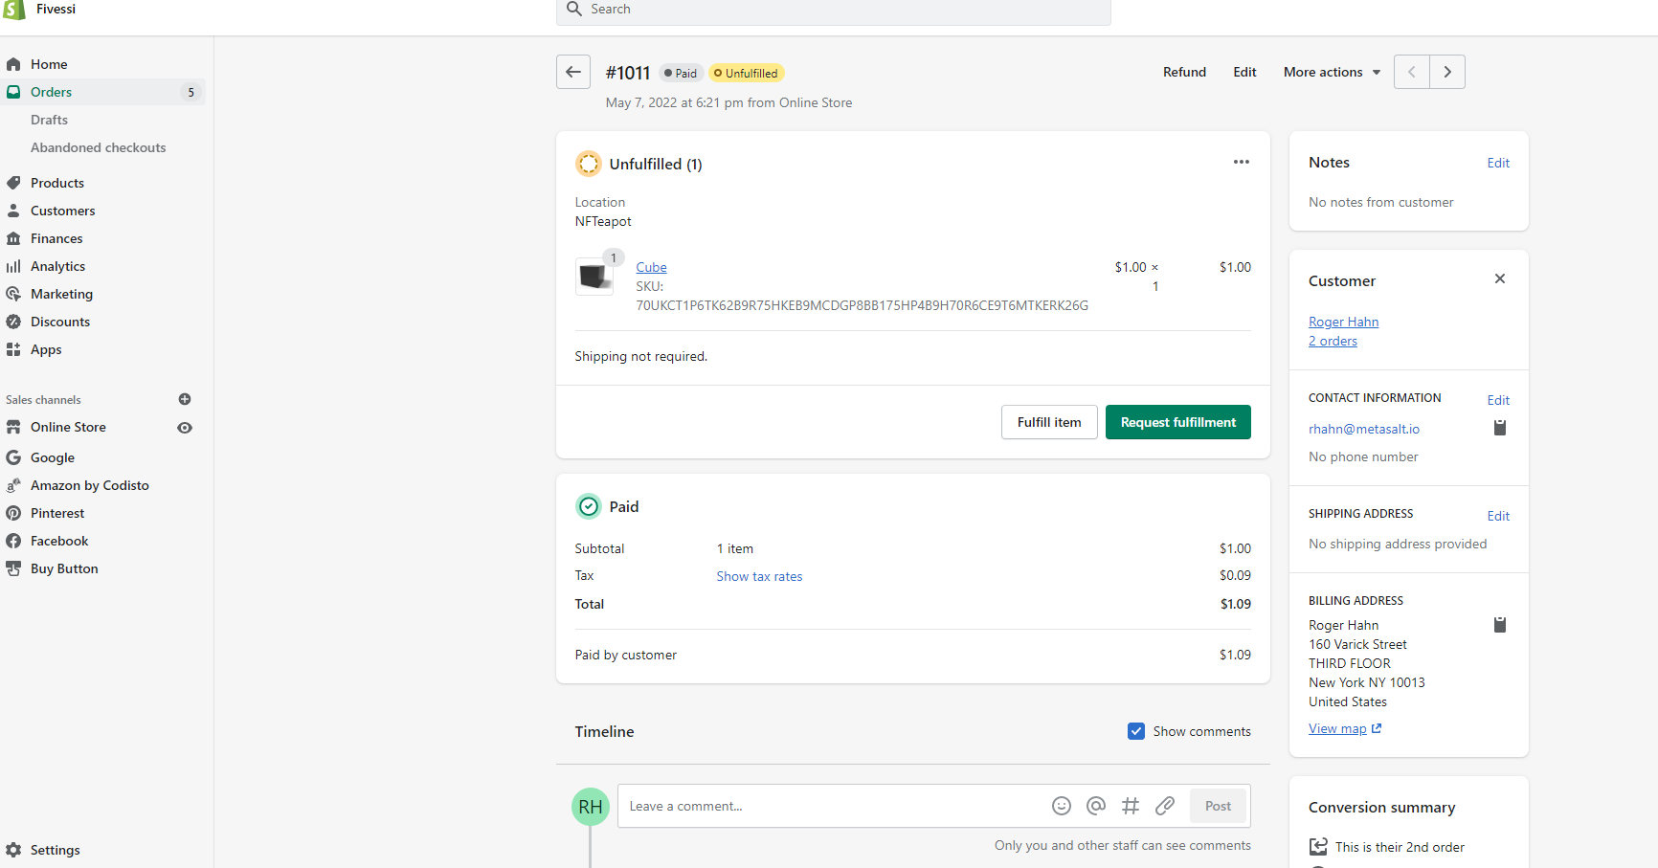
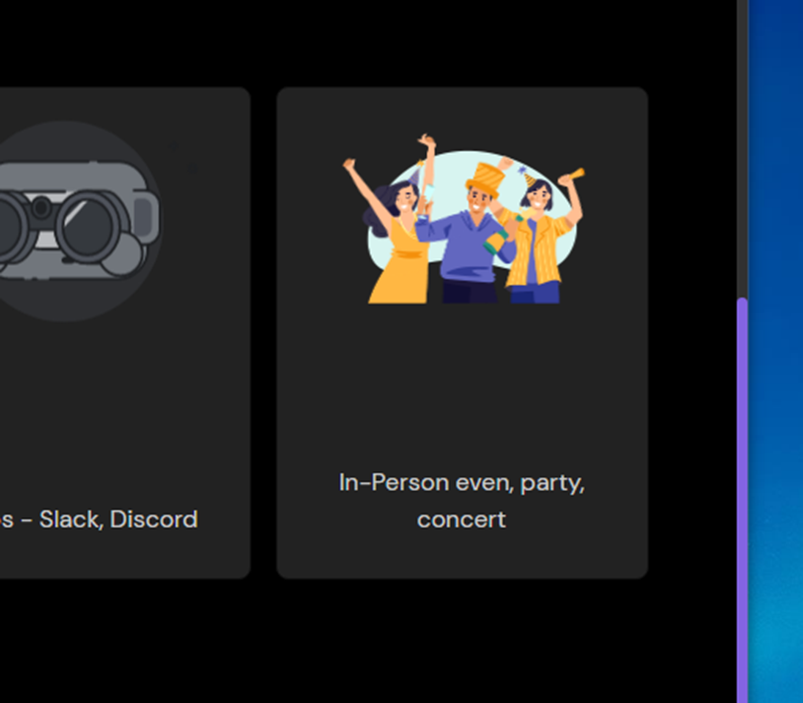
Admin/Orders page

Slide 6
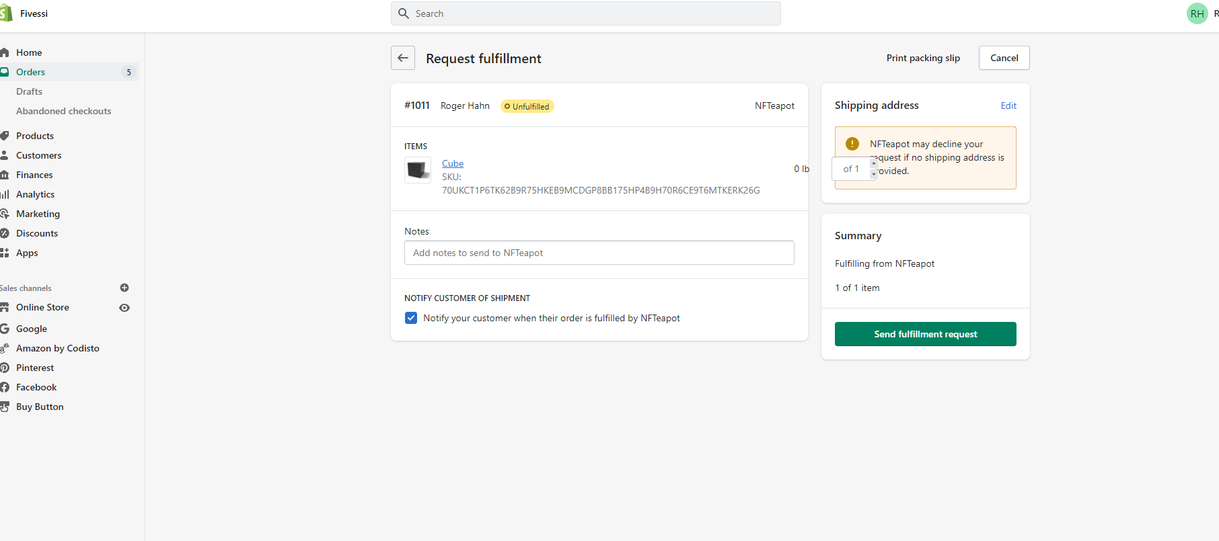
Fulfillment Page

Slide 7
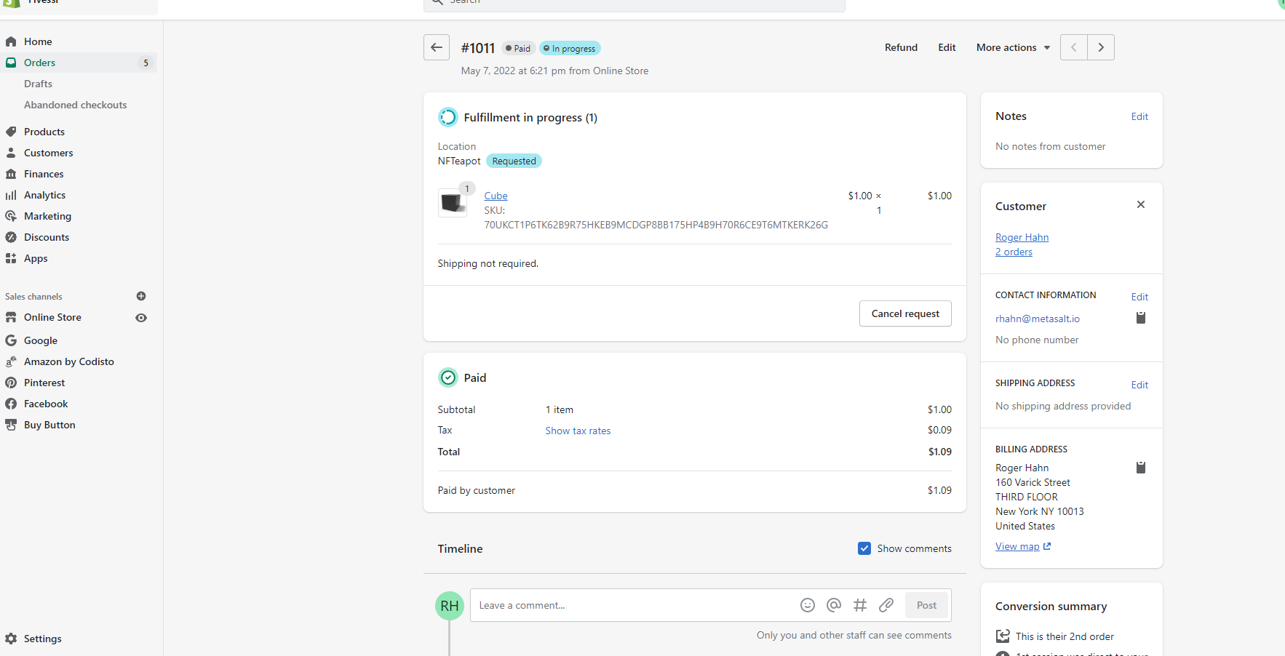
Back to Admin Orders page

Slide 8
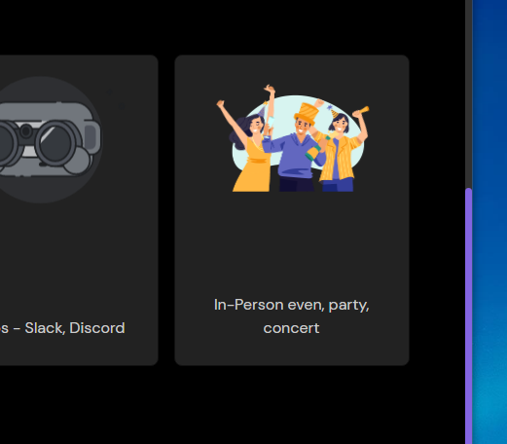

Slide 9
Name of Event
Date
Period
Links
Description
NFTS
Tier 1, Tier 2, Tier 3

